Slide 1
ALIGN RF Blocks
Jitesh Poojary

Slide 2
Agenda
RF Receiver System
RF blocks & layout
Phased array chip

Slide 3
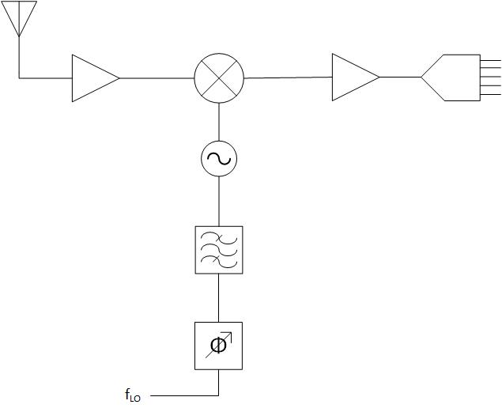
RF Wireless system
Radio Frequency Circuits
Low Noise Amplifier (LNA)
Mixers
Oscillators
Filters
RF section
Baseband Section
Baseband Amplifier
LNA
Mixer
ADC
Oscillator
BPF
Phase Shifter
Fig 1. RF receiver system

Slide 4
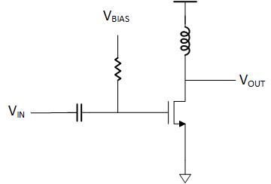
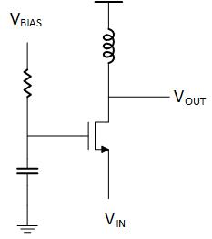
Low Noise Amplifier
Features:
Low Noise
Sets Noise figure to certain level
Typically single level transistor design
Fig 2. Common Source (CS) Type
Fig 3. Common Gate (CG) type

Slide 5
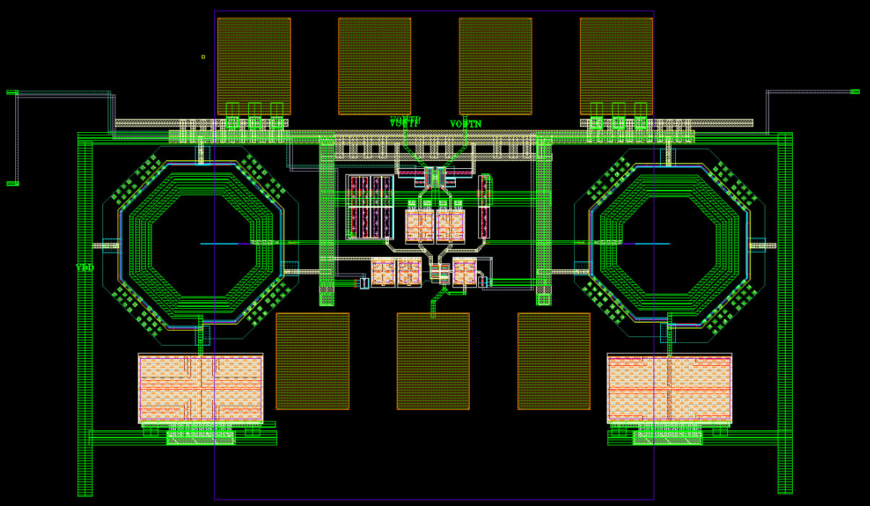
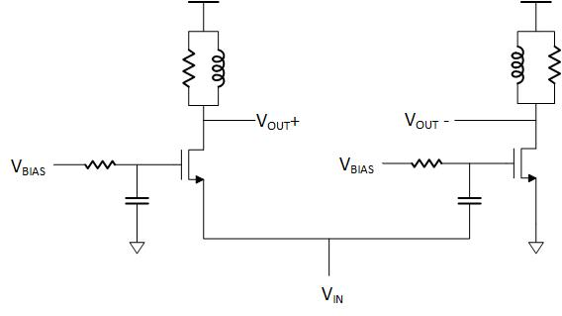
Low Noise Amplifier
CG
CS
Fig 4. Differential Configuration LNA and its layout

Slide 6
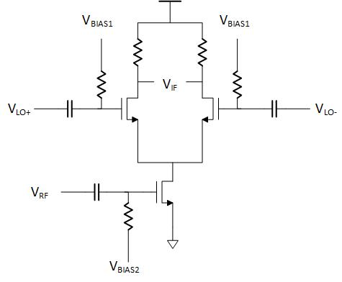
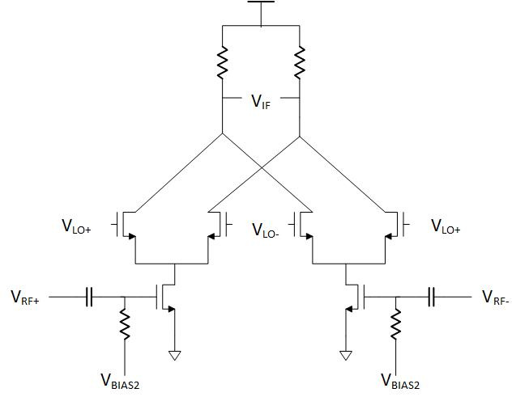
Mixer
Features:
Converts RF signal to baseband signal
2 RF level inputs
Fig 5. Single Balanced Mixer
Fig 6. Double Balanced Mixer

Slide 7
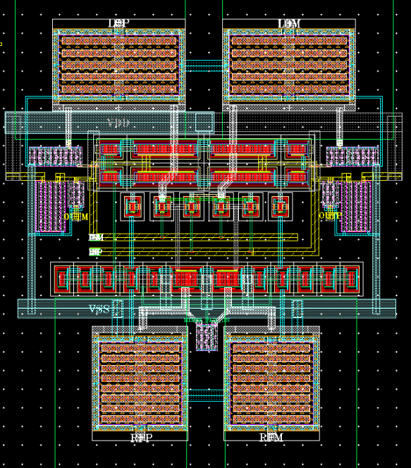
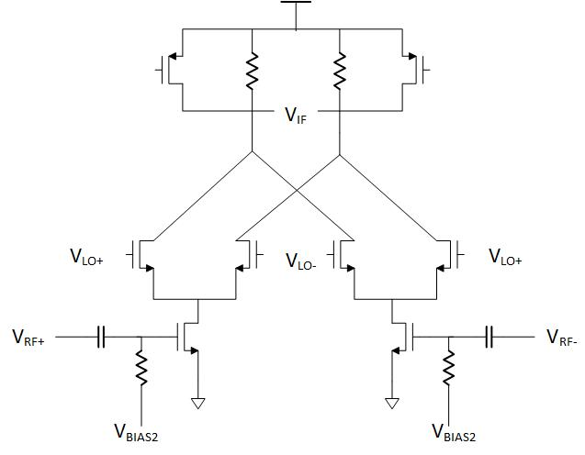
Mixer
LO
RF
Fig 7. Improved Double Balanced Mixer and its layout

Slide 8
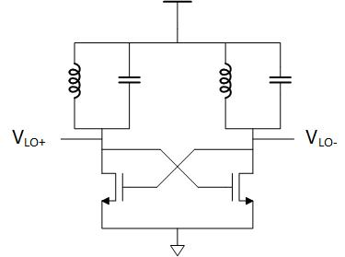
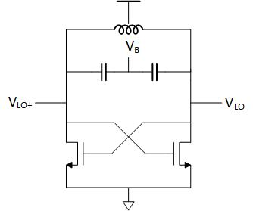
Oscillator
Features:
Contains inductor and capacitor in parallel combination
Cross – coupled Transistors
Fig 8. Cross coupled oscillator Type I
Fig 9. Cross coupled oscillator Type II

Slide 9
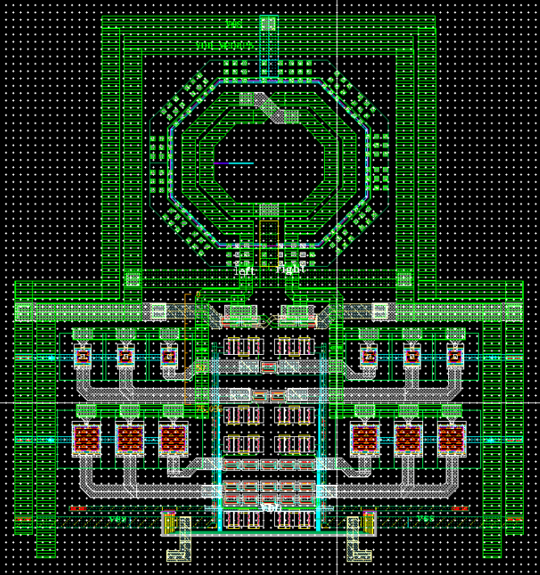
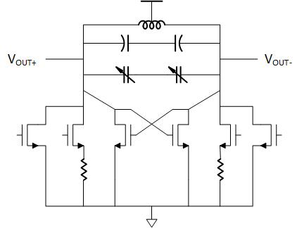
Oscillator
Inductor
MIM Cap
Fig 10. Cross coupled oscillator Type 2 and its layout

Slide 10
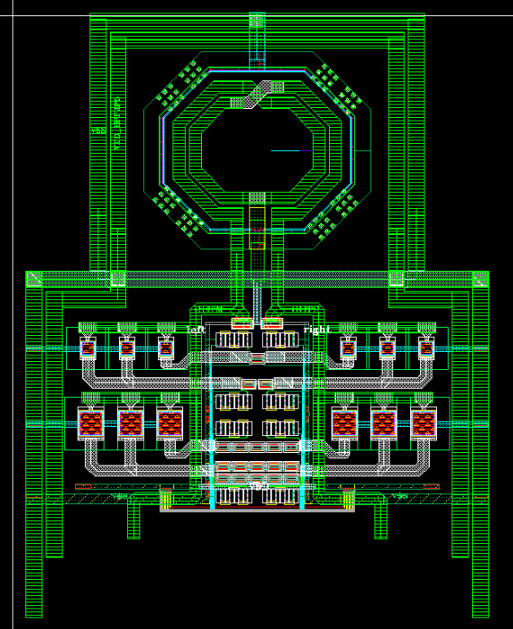
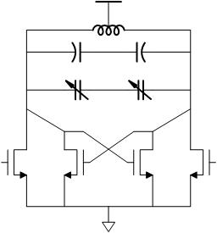
Filter
Fig 11. Band Pass filter and its layout

Slide 11
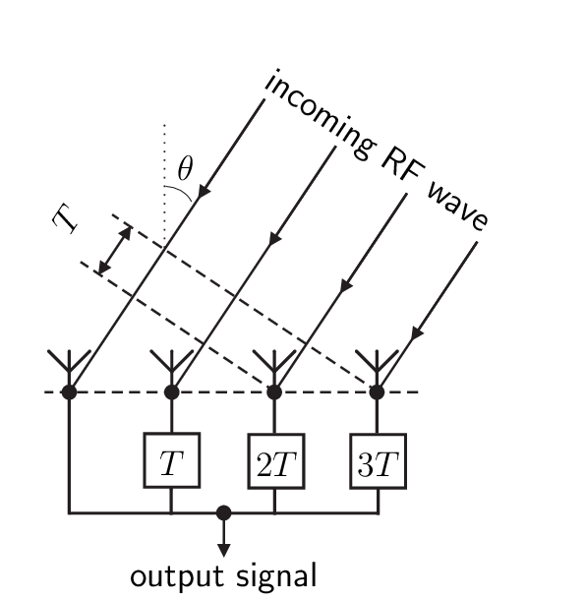
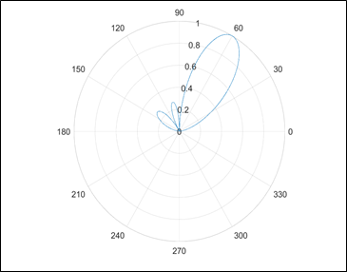

Phased Array System
Applications:
MIMO communication
RADAR
$$\sin\left[w\left(t−t0\right)\right]=sin⁡[(wt+Φ)]$$
Fig 12. RF wave received at an angle
Fig 13. Beamforming in phased array

Slide 12
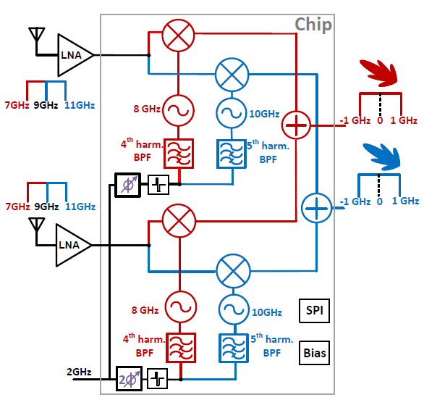
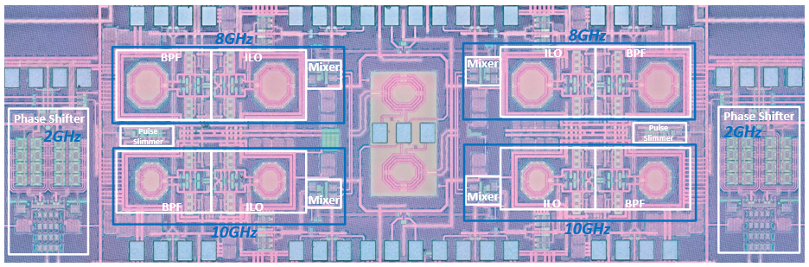
Full Chip Phased Array
Fig 14. Full chip block diagram of 2 antenna phased array and chip micrograph

